Slide 1

FOODIE ON CLOUD Project Synopsis Presentation Date: 24/02/2023
Course : MAJOR PROJECT(ICI652)
Degree : BCA(CTIS)
Project Guide:
Vijay Prakash Sir
Manisha Singh (TCA2056014)
Tanya Pal (TCA2056023)
FACULTY OF ENGINEERING & COMPUTING SCIENCES
TEERTHANKER MAHAVEER UNIVERSITY, MORADABAD

Slide 2

Team Details
Student Name | Role
Manisha singh | Developer, Testing etc.
Tanya Pal | Developer, Testing etc.
2

Slide 3
Table of contents
Project Brief
Methodologies/Technologies/Tools to be used
Data Flow Diagram
Entity-Relation Diagram
Feature
Reference
da
3

Slide 4
Project Brief
The Foodie on cloud is a Web Application built using MERN stack.
It covers some very fundamental and necessary features for the Web Application. It has proper user authentication and authorization. It handles sessions very well with the help of Redis DB. Firebase is used for uploading and retrieving images.
Foodie on cloud allows all CRUD operations on menu items. It is built using MERN stack and utilizes certain other technologies. It also allows Sign In using Google and Facebook.
4
T011A/ Template Version 5.0

Slide 5
Methodologies/Technologies/Tools to be used
Frontend :-
1.HTML,CSS
2.React
Backend:-
1.Javascript
2.Nodejs
Database:-
1.MongoDB
Tool:-
Vscode
5

Slide 6
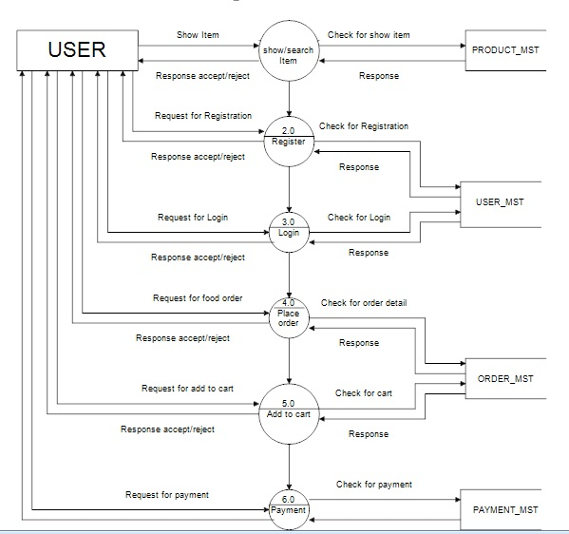
Data Flow Diagram
6

Slide 7
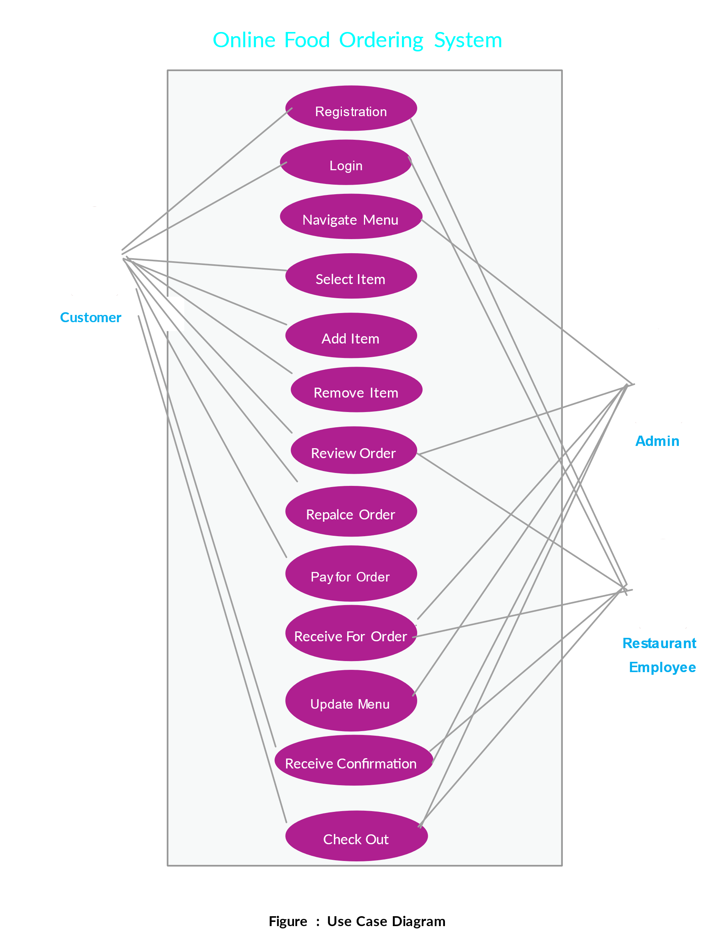
Entity Relation Diagram
7

Slide 8
\
Feature of The Project
Add, Edit, Delete Menu items for admin user
Session management (based on user activity)
User authentication and authorization
Email verification using OTP
Google and Facebook Sign Up
Upload menu item images
i18n support
Sorting, Pagination and filtering on menu items
Soft delete on database records
Error handling on front-end and back-end
404 Page handling
Forgot password with OTP verification
Error, Success, warning messages to the user
Logger middle wares
8

Slide 9
References
https://github.com/hetsuthar028/restaurant-app-wt
9

Slide 10
THANKS

